Slide 1
July 17, 2026
Hari Naicker
Biweekly Meeting Recap
Python Integration with NCFL

Slide 2
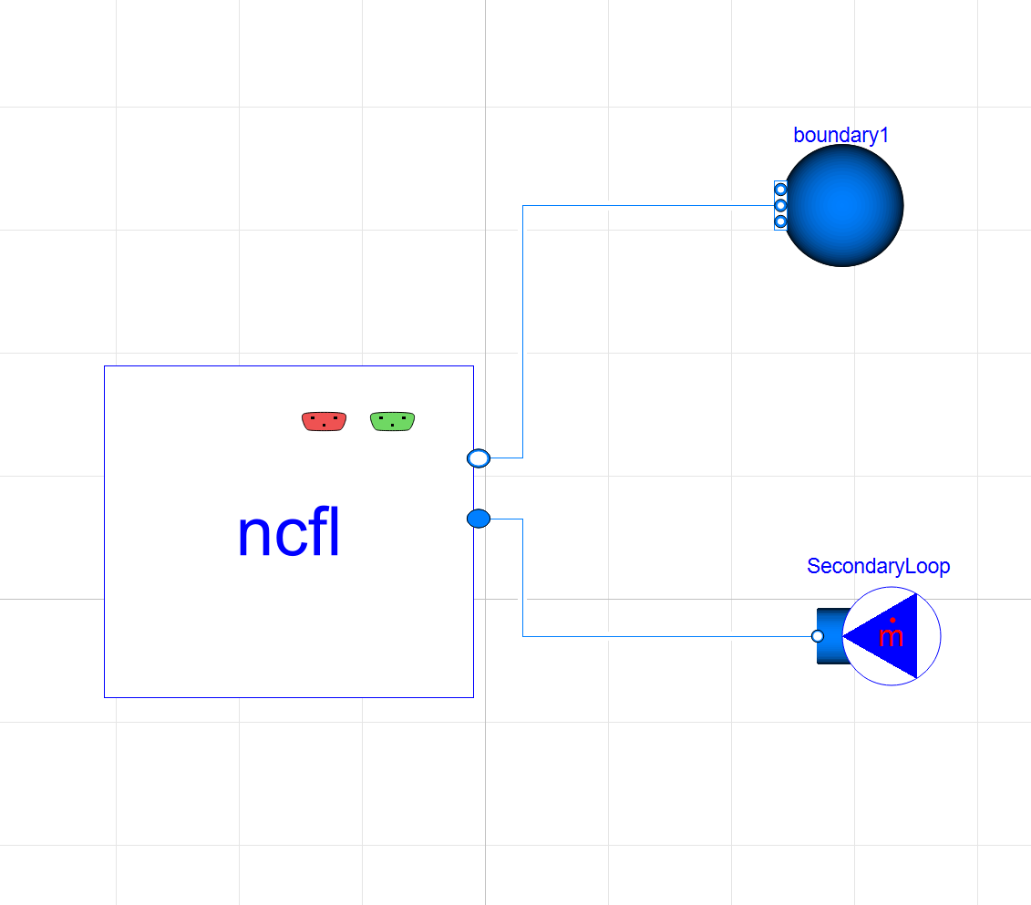
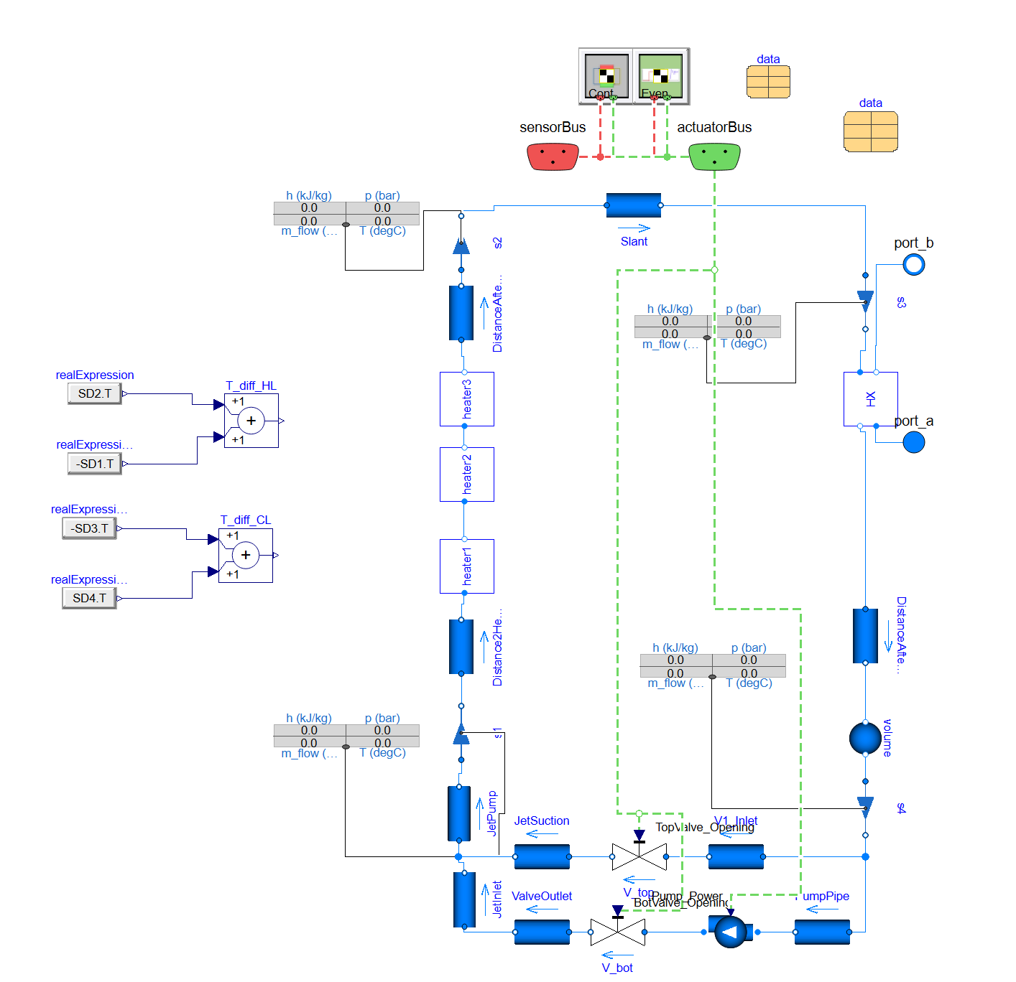
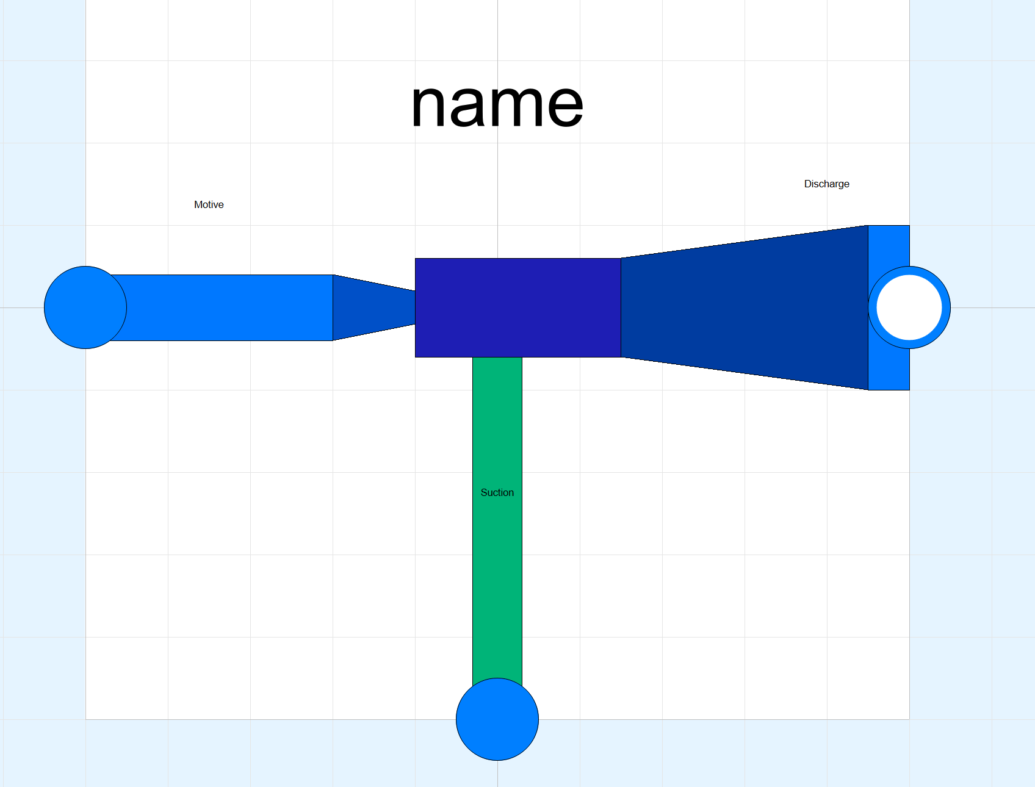
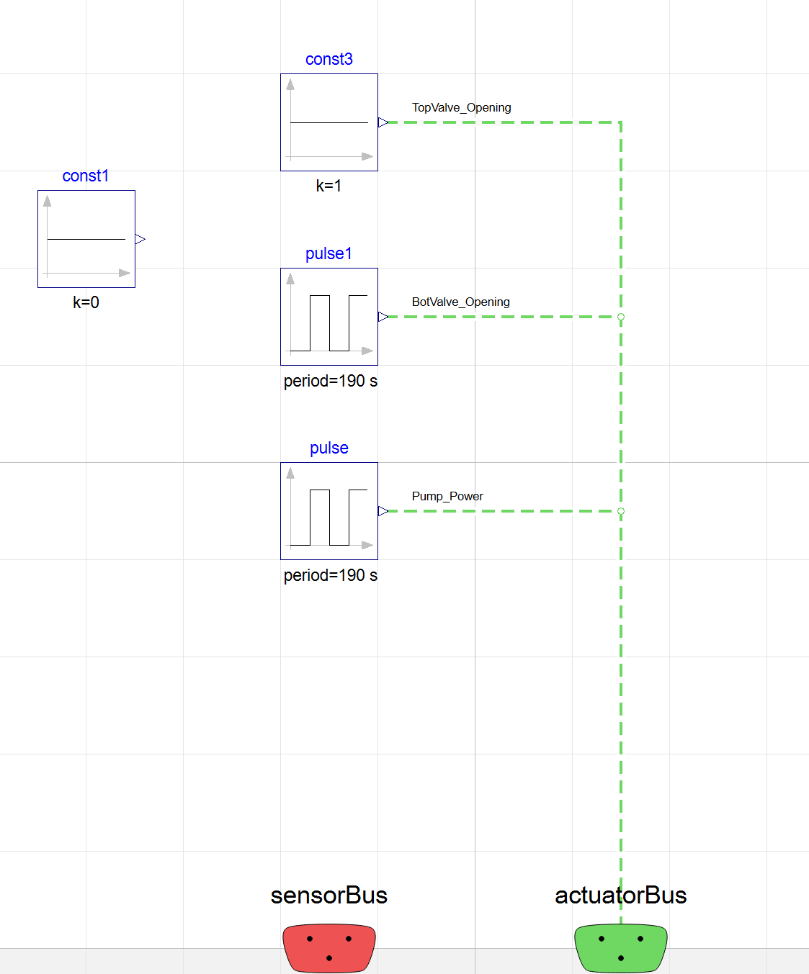
NCFL Dymola Model update
Modular design with swappable CS
Modelled all components
  Jet pump
  Top and bottom valves
Implemented multiple cases studies to verify with experimental data
Confirmed natural circulation worked

Slide 3
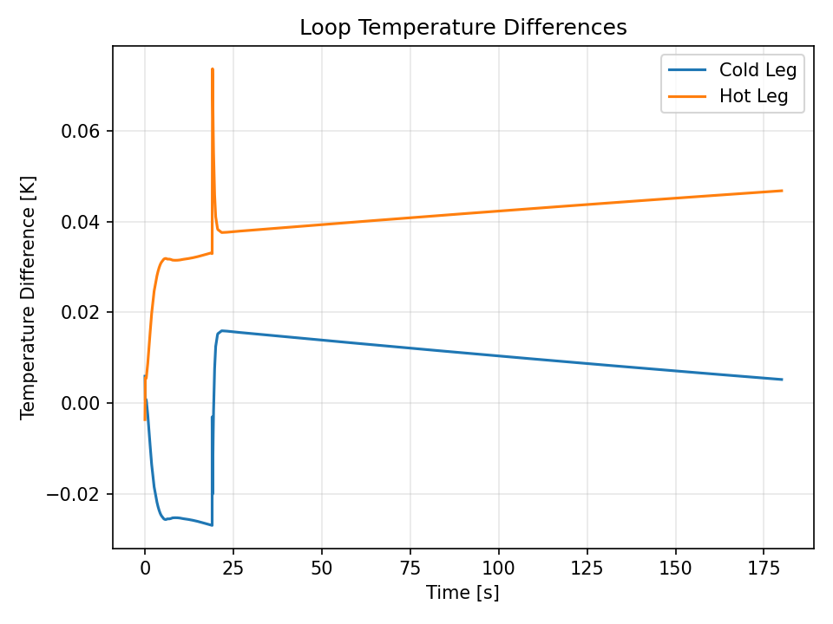
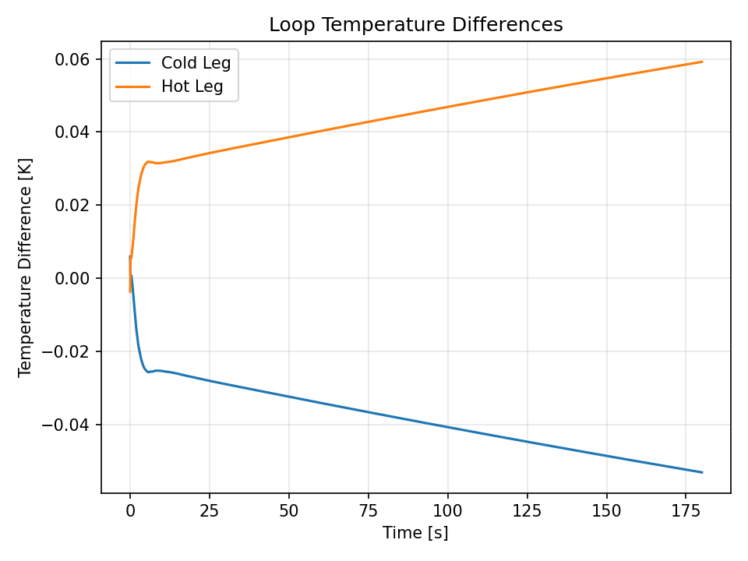
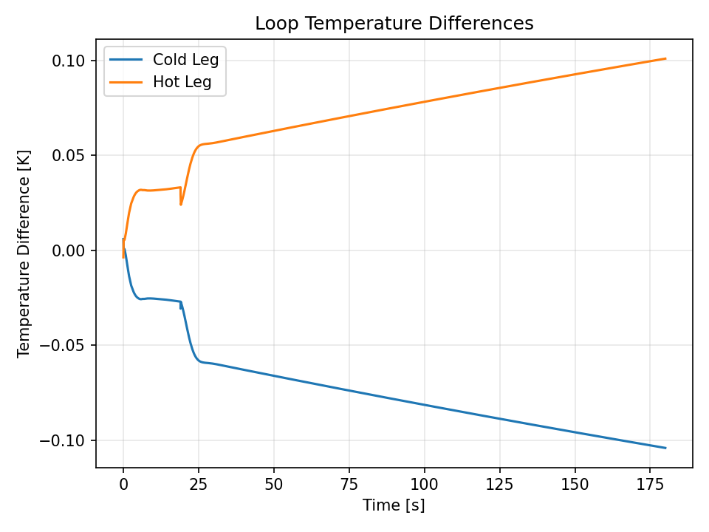
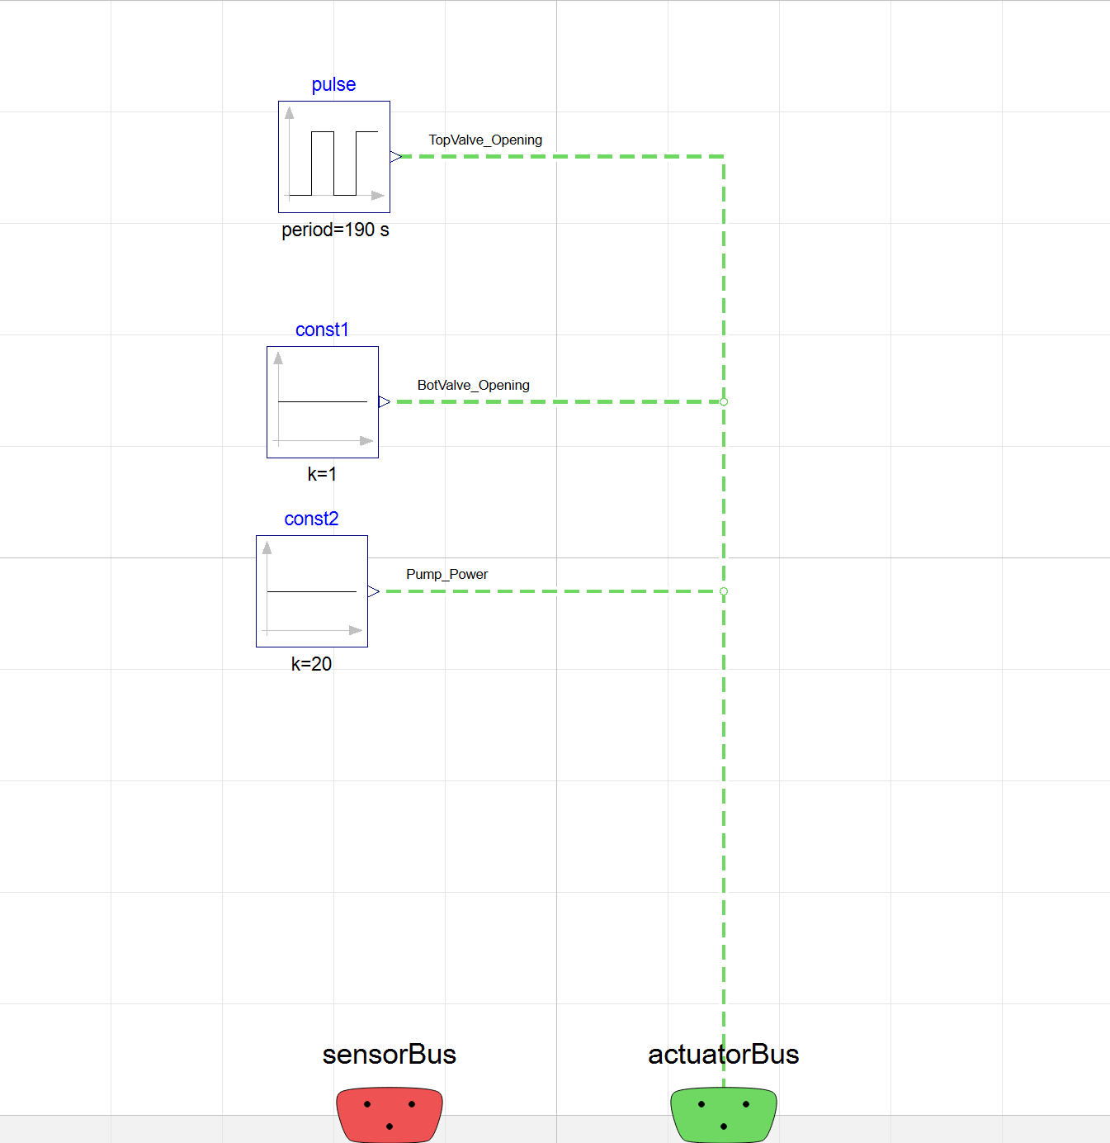
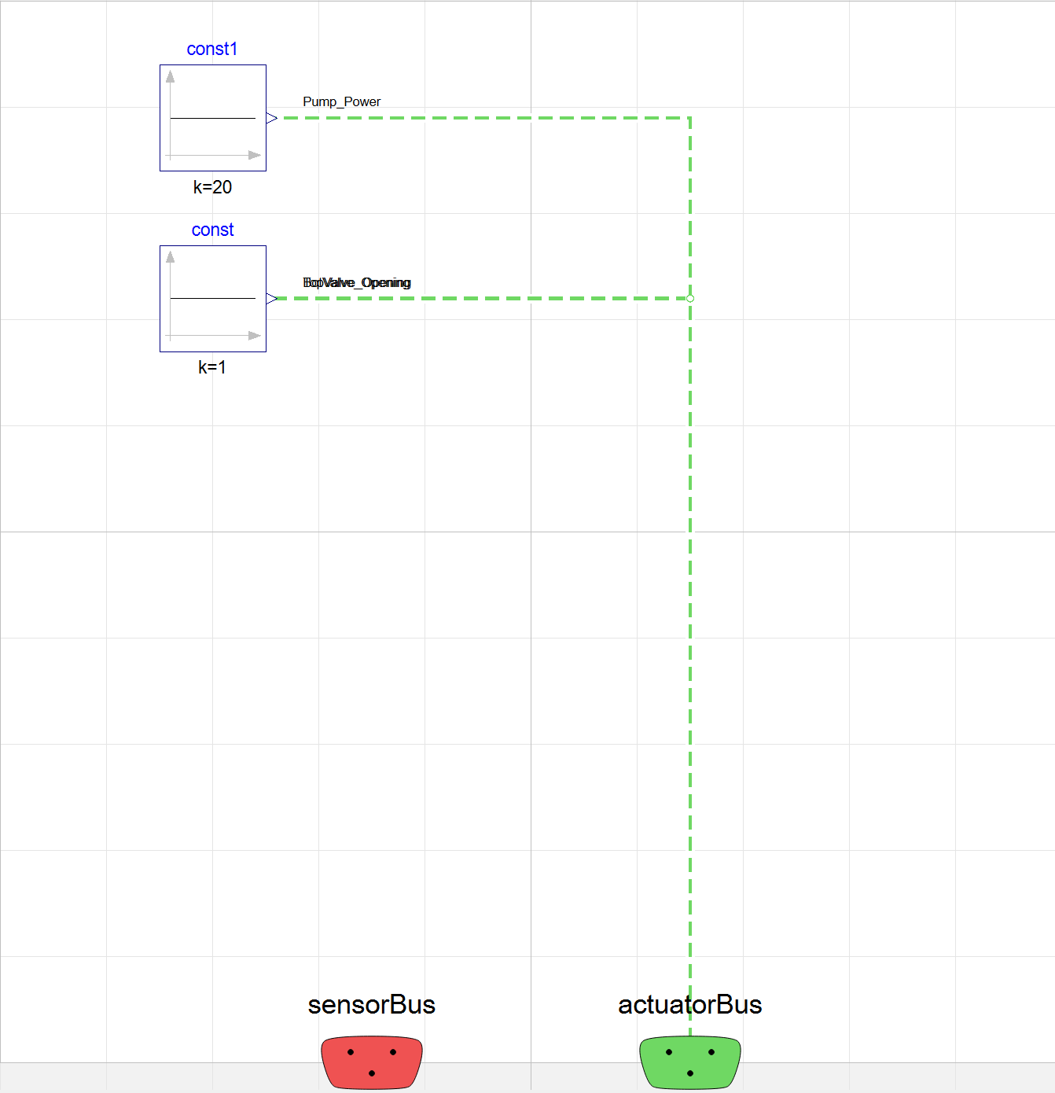
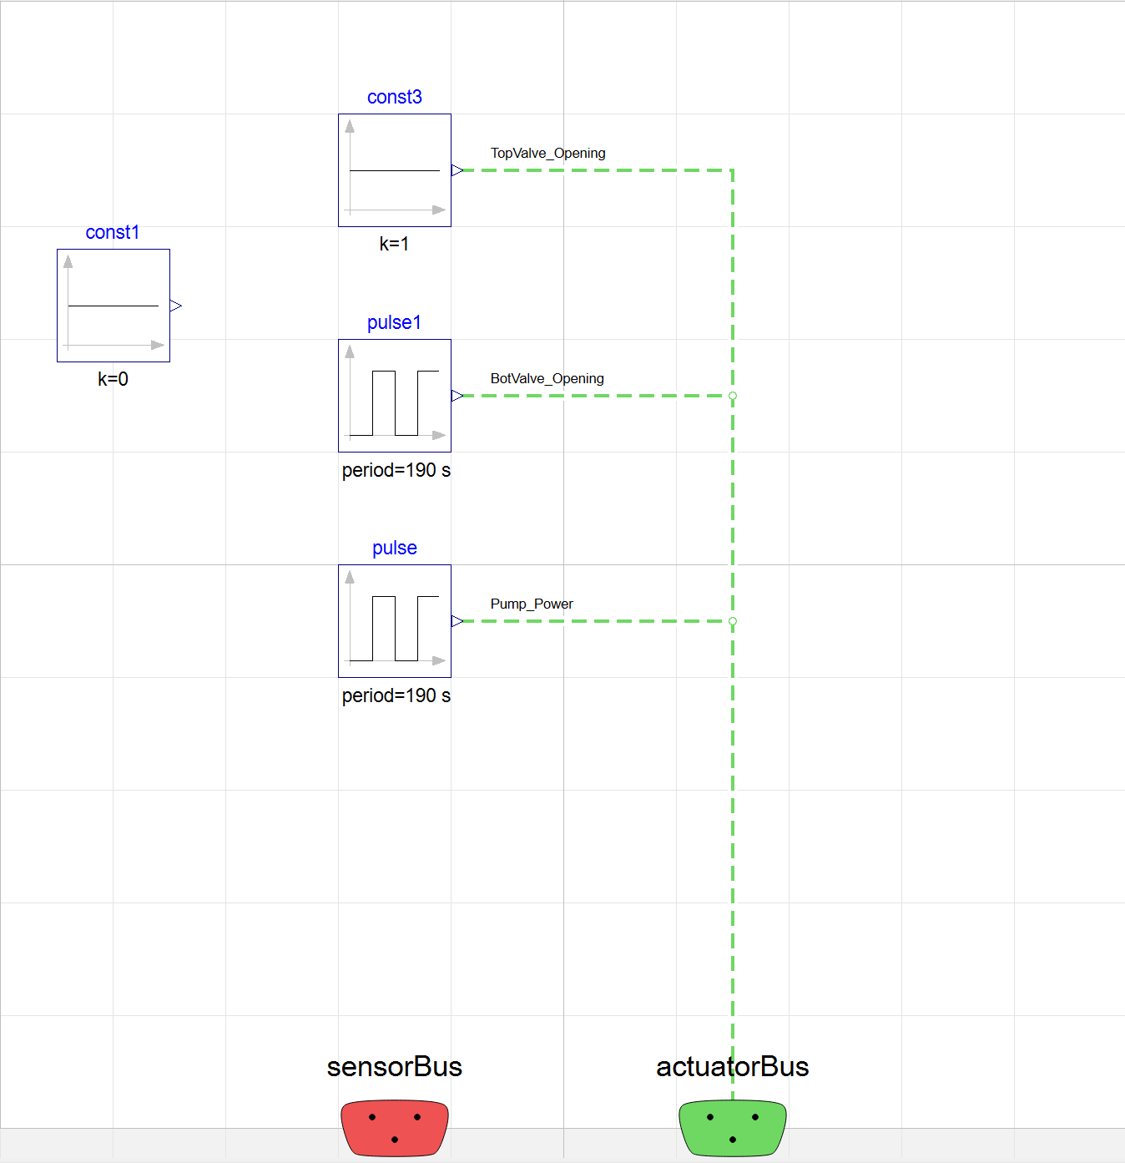
Simulation References

Slide 4
Python Integration with NCFL
Created a script to run the NCFL modular file
Any variable values can be changed in the Python file
Overseeing structures such as the control system can also be modified in the Python interface
Started setting up HPC integration to run multiple runs, like what Nick did
Have started learning more about sensitivity studies such as the Morris analysis done on the HITB
Future work:
  Running into issues not previously encountered with Docker access
    PostgresSQL
  Data stream reconstruction
    Still trying to understand how the code is structured

